Slide 1

Welcome
October 13, 2019
Guest Speaker:
Rev. Mark Kiyimba
Before the service or during the musical meditation, you are welcome to light a candle in the window. Please place lighting sticks in the sand, hot end down.
Notes:
Display at the start of Service through the announcements.

Slide 2
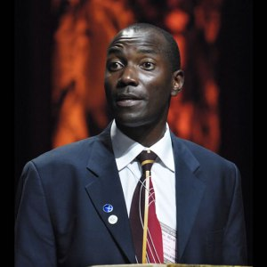
Notes:
Play video clip titled “Kiyimba clip1-intro.mp4”

Slide 3
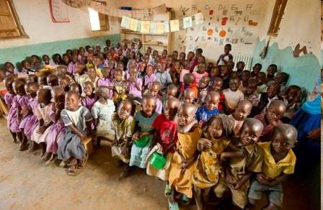
New Life Primary School, Uganda
Notes:
Display from Prelude through Invocation

Slide 4
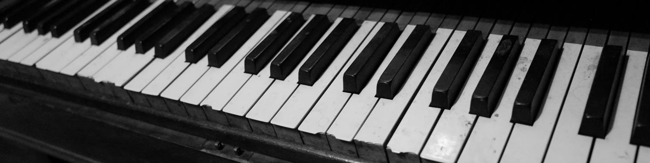
Opening Hymn
“Enter, Rejoice & Come In”
#361
Notes:
Display *briefly* while hymn is introduced – advance when accompanist begins playing.
#361, one slide

Slide 5

verse 1: Enter, rejoice, and come in.
Enter, rejoice, and come in.
Today will be a joyful day;
Enter, rejoice, and come in.
verse 2: Open your ears to the song . . .
verse 3: Open your hearts ev'ry-one . . .
verse 4: Don't be afraid of some change . . .
verse 5: Enter, rejoice, and come in . . .
Notes:
hymn 1064 in blue book

Slide 6

Responsive Reading
“Religion”
#466
—Vincent B. Silliman
Notes:
Display when Responsive Reading is introduced

Slide 7
Let religion be to us life and joy.
Let it be a voice of renewing challenge to the best we have and may be; let it be a call to generous action.
Let religion be to us a dissatisfaction with things that are, which bids us serve more eagerly the true and right.
Let it be the sorrow that opens for us the way of sympathy, understanding, and service to suffering humanity.
Notes:
responsive reading #466 -- 1 of 3

Slide 8
Let religion be to us the wonder and lure of that which is only partly known and understood:
An eye that glories in nature’s majesty and beauty, and a heart that rejoices in deeds of kindness and of courage.
Let religion be to us security and serenity because of its truth and beauty, and because of the enduring worth and power of the loyalties which it engenders;
Let it be to us hope and purpose, and a discovering of opportunities to express our best through daily tasks:
Notes:
responsive reading #466, 2 of 3

Slide 9

Religion, uniting us with all that is admirable in human beings everywhere;
Holding before our eyes a prospect of the better life for humankind, which each may help to make actual.
Notes:
Reading #466, 3 of 3

Slide 10
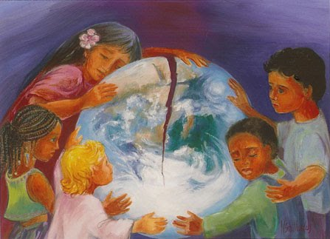
Congregational Covenant
Love is the spirit of this church
and service is its law.
This is our great covenant:
to dwell together in peace,
to seek the truth in freedom,
and to help one another.
Notes:
Display during Congregational Covenant

Slide 11
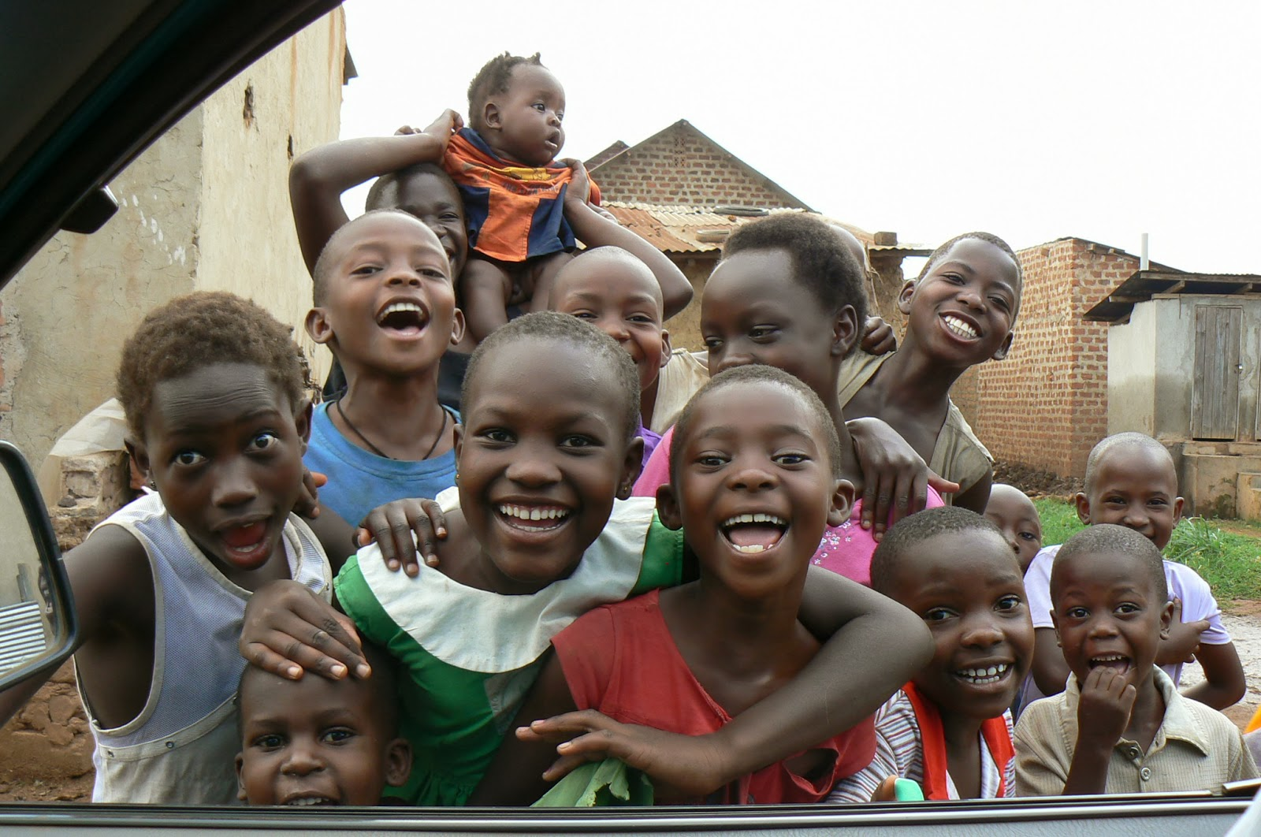
Greeting the Holy in Our Midst
Notes:
Display during Greeting the Holy in Our Midst

Slide 12

Message for All Ages
Notes:
Introduction only

Slide 13
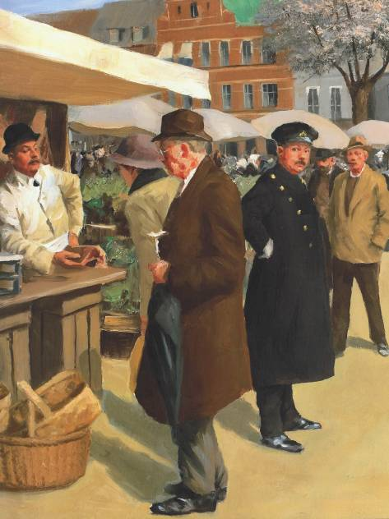
Notes:
cue to advance: “…all were loyal subjects of their beloved King Christian.”

Slide 14
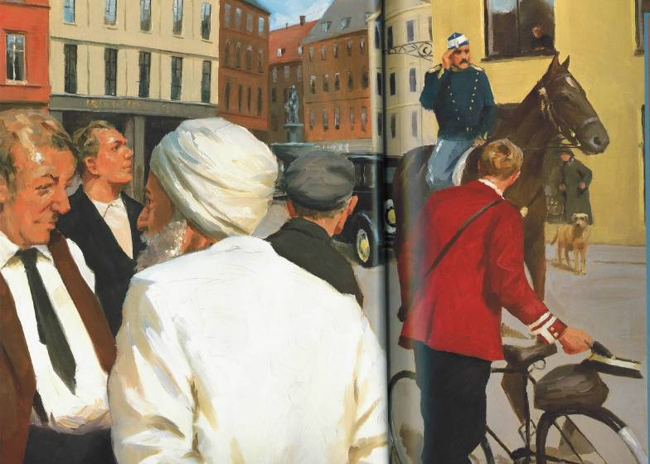
Notes:
cue: “…their wise king in the dark days to come.”

Slide 15
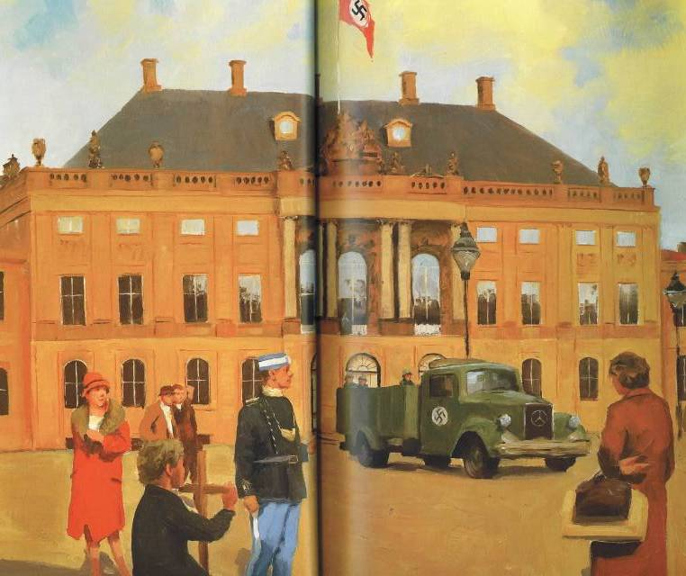
Notes:
cue: “…King Christian sent a Danish soldier to remove the flag.”

Slide 16
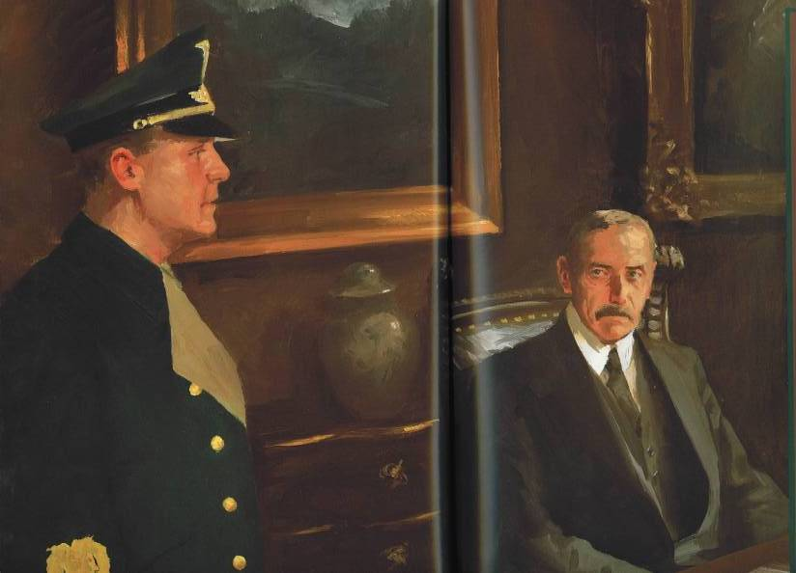
Notes:
cue: “…The Nazi flag did not fly from the palace again.”

Slide 17
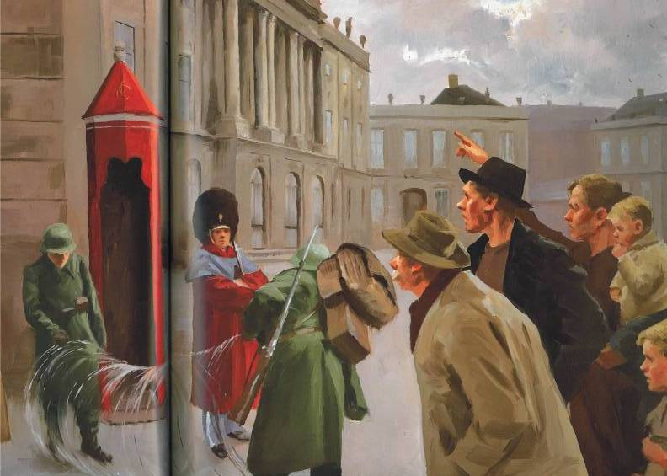
Notes:
cue: “…greatest test was still to come.”

Slide 18
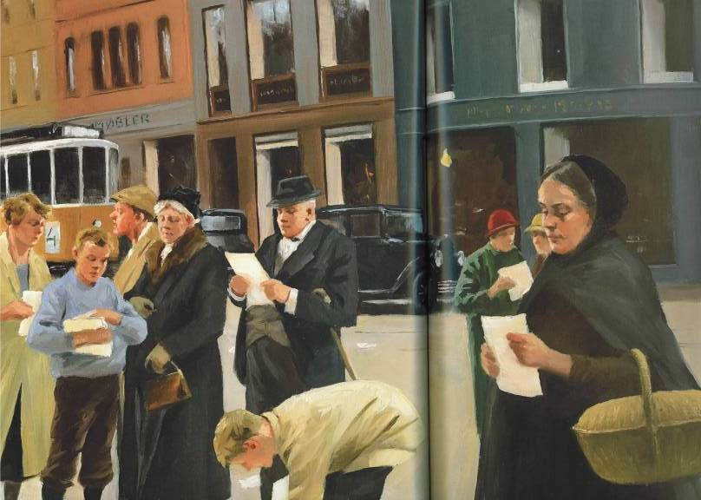
Notes:
cue: “…must be visible at all times!”

Slide 19
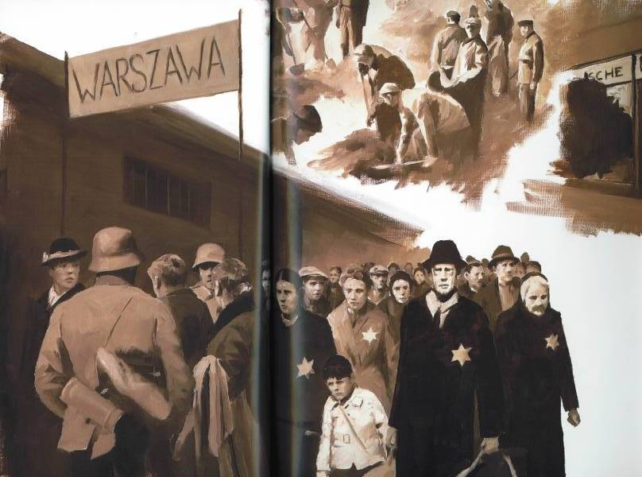
Notes:
cue: “…As before, the people looked to their King.”

Slide 20
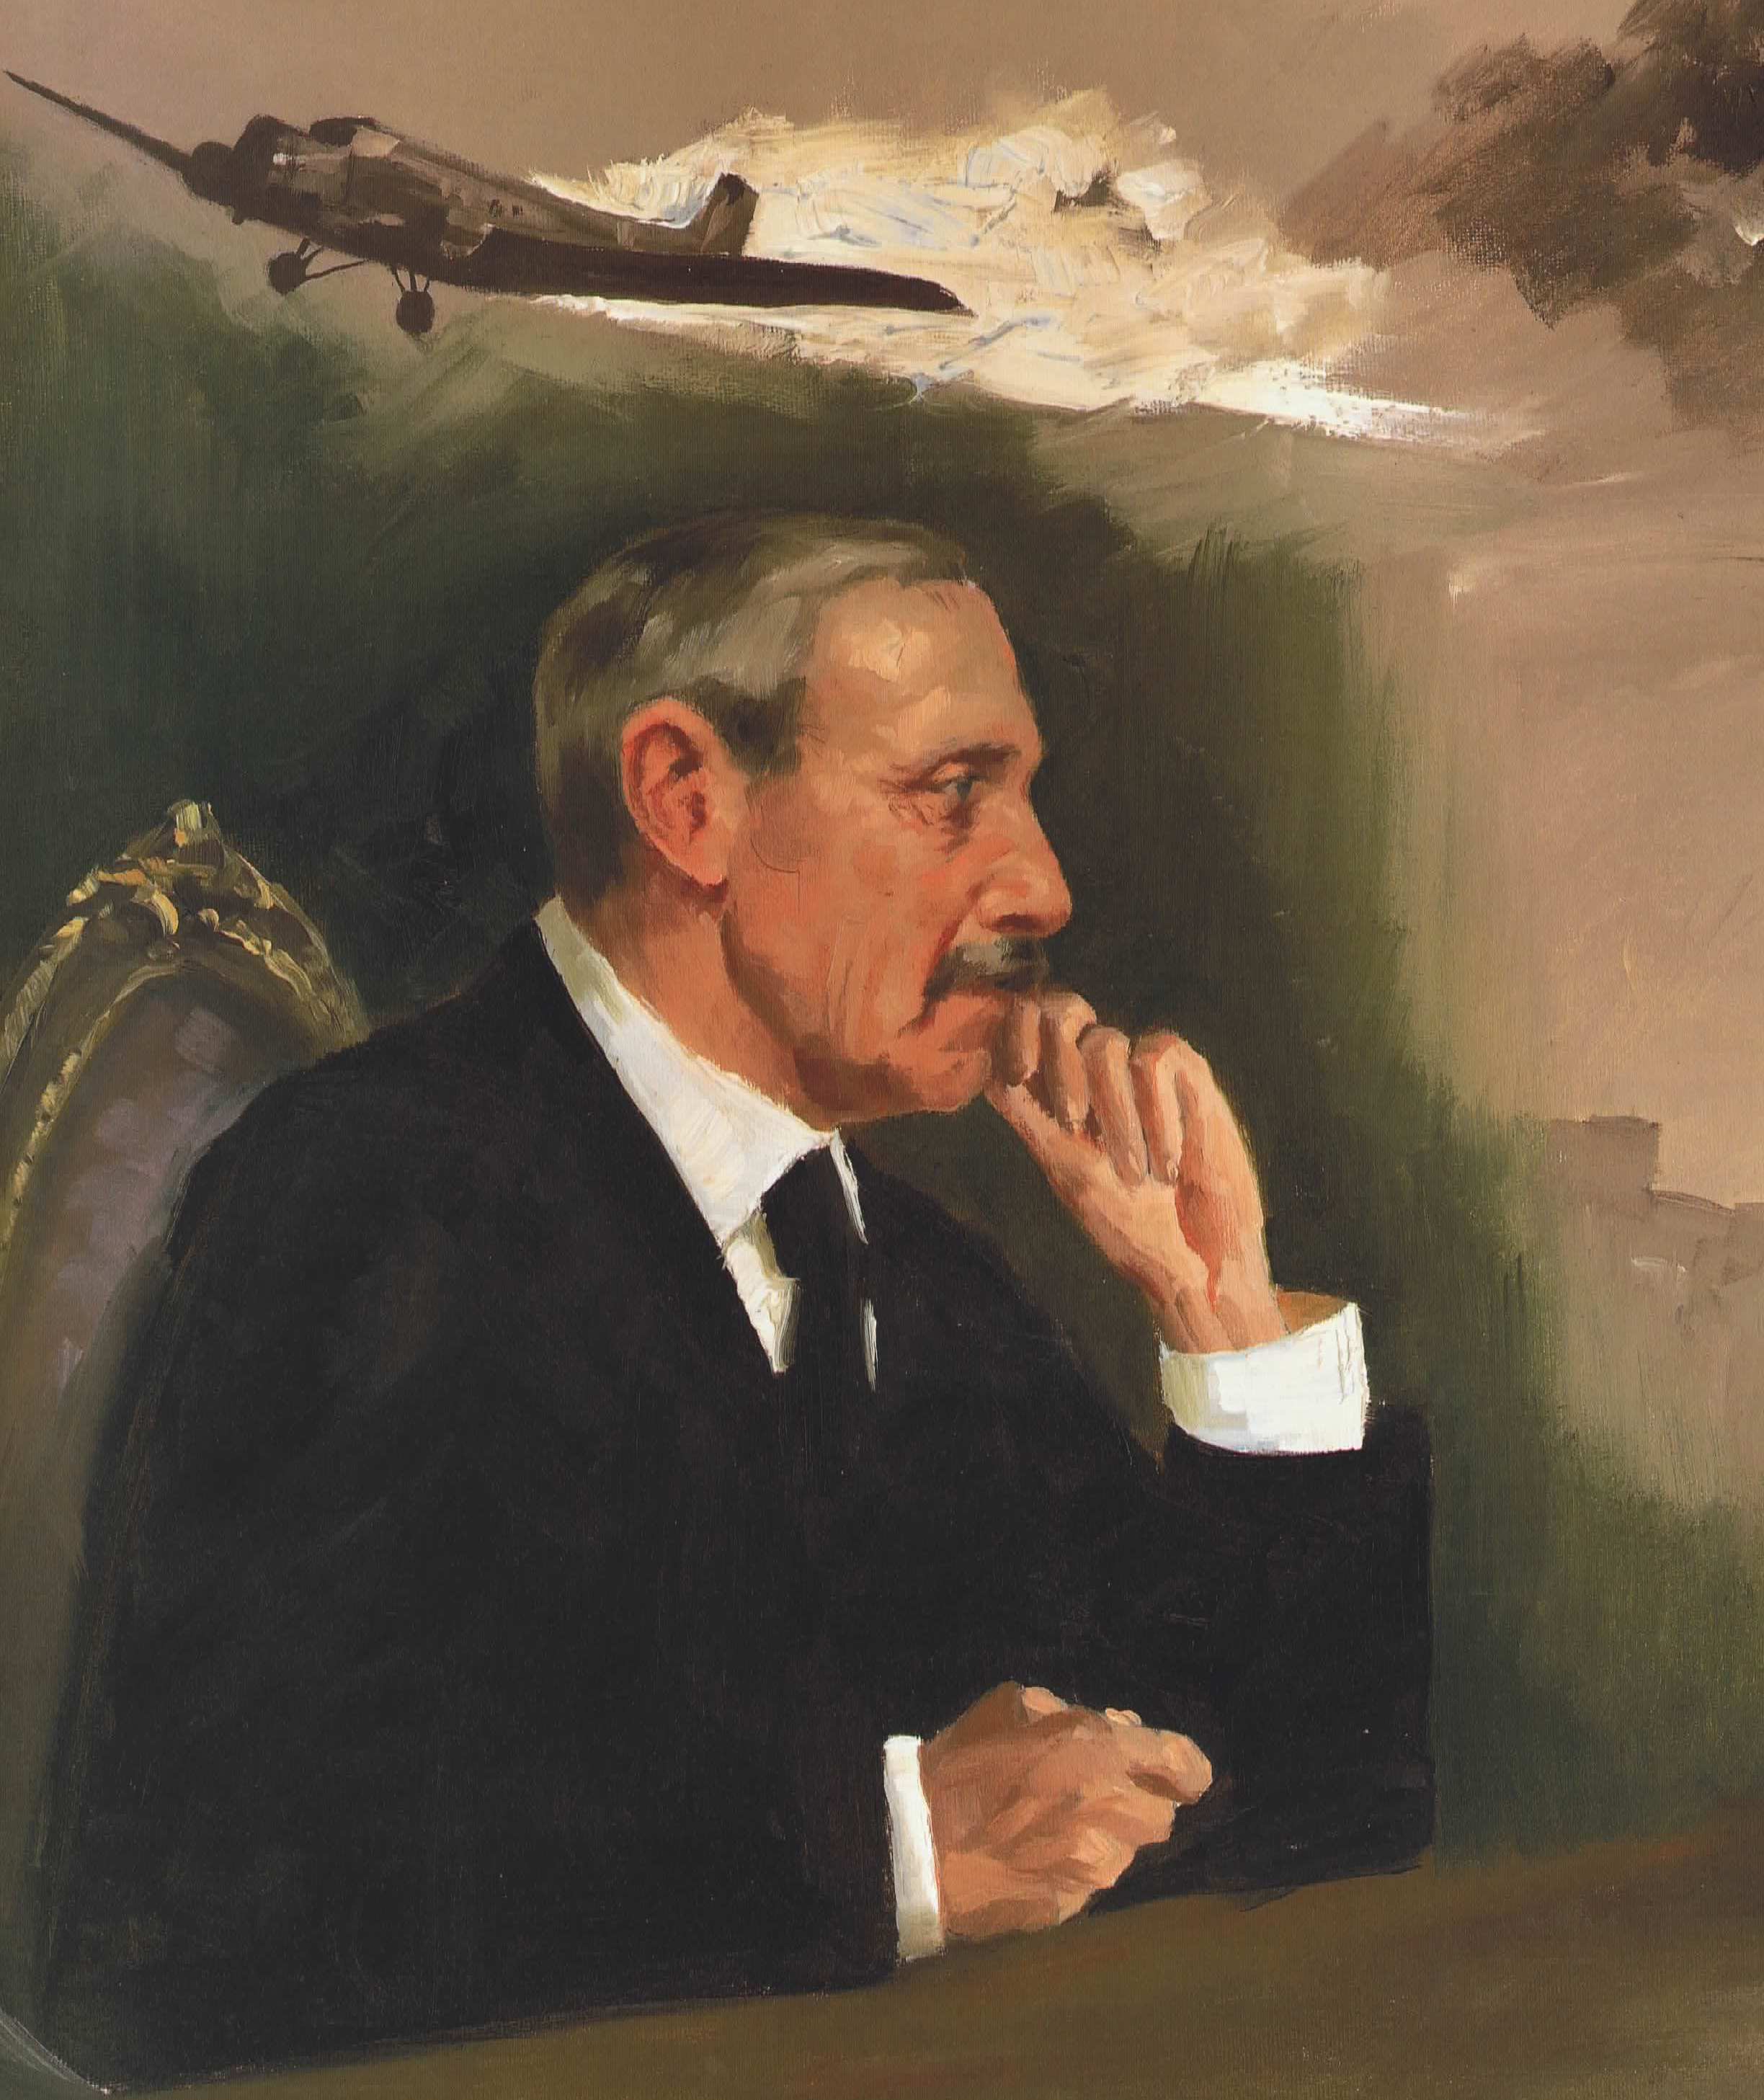
Notes:
cue: “…If he did nothing, Danes would die.”

Slide 21
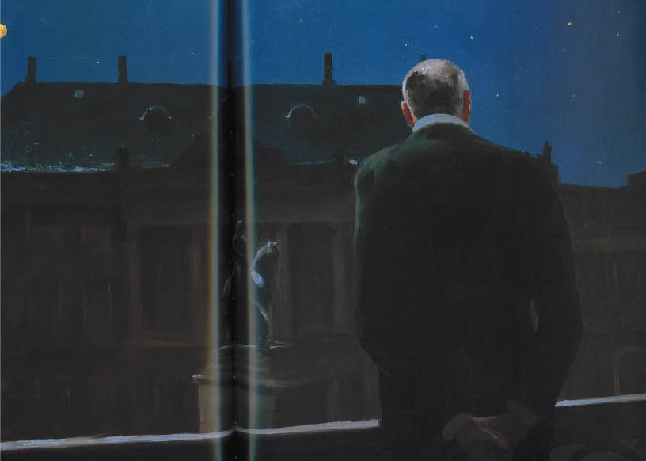
Notes:
cue: “…The king summoned his tailor.”

Slide 22
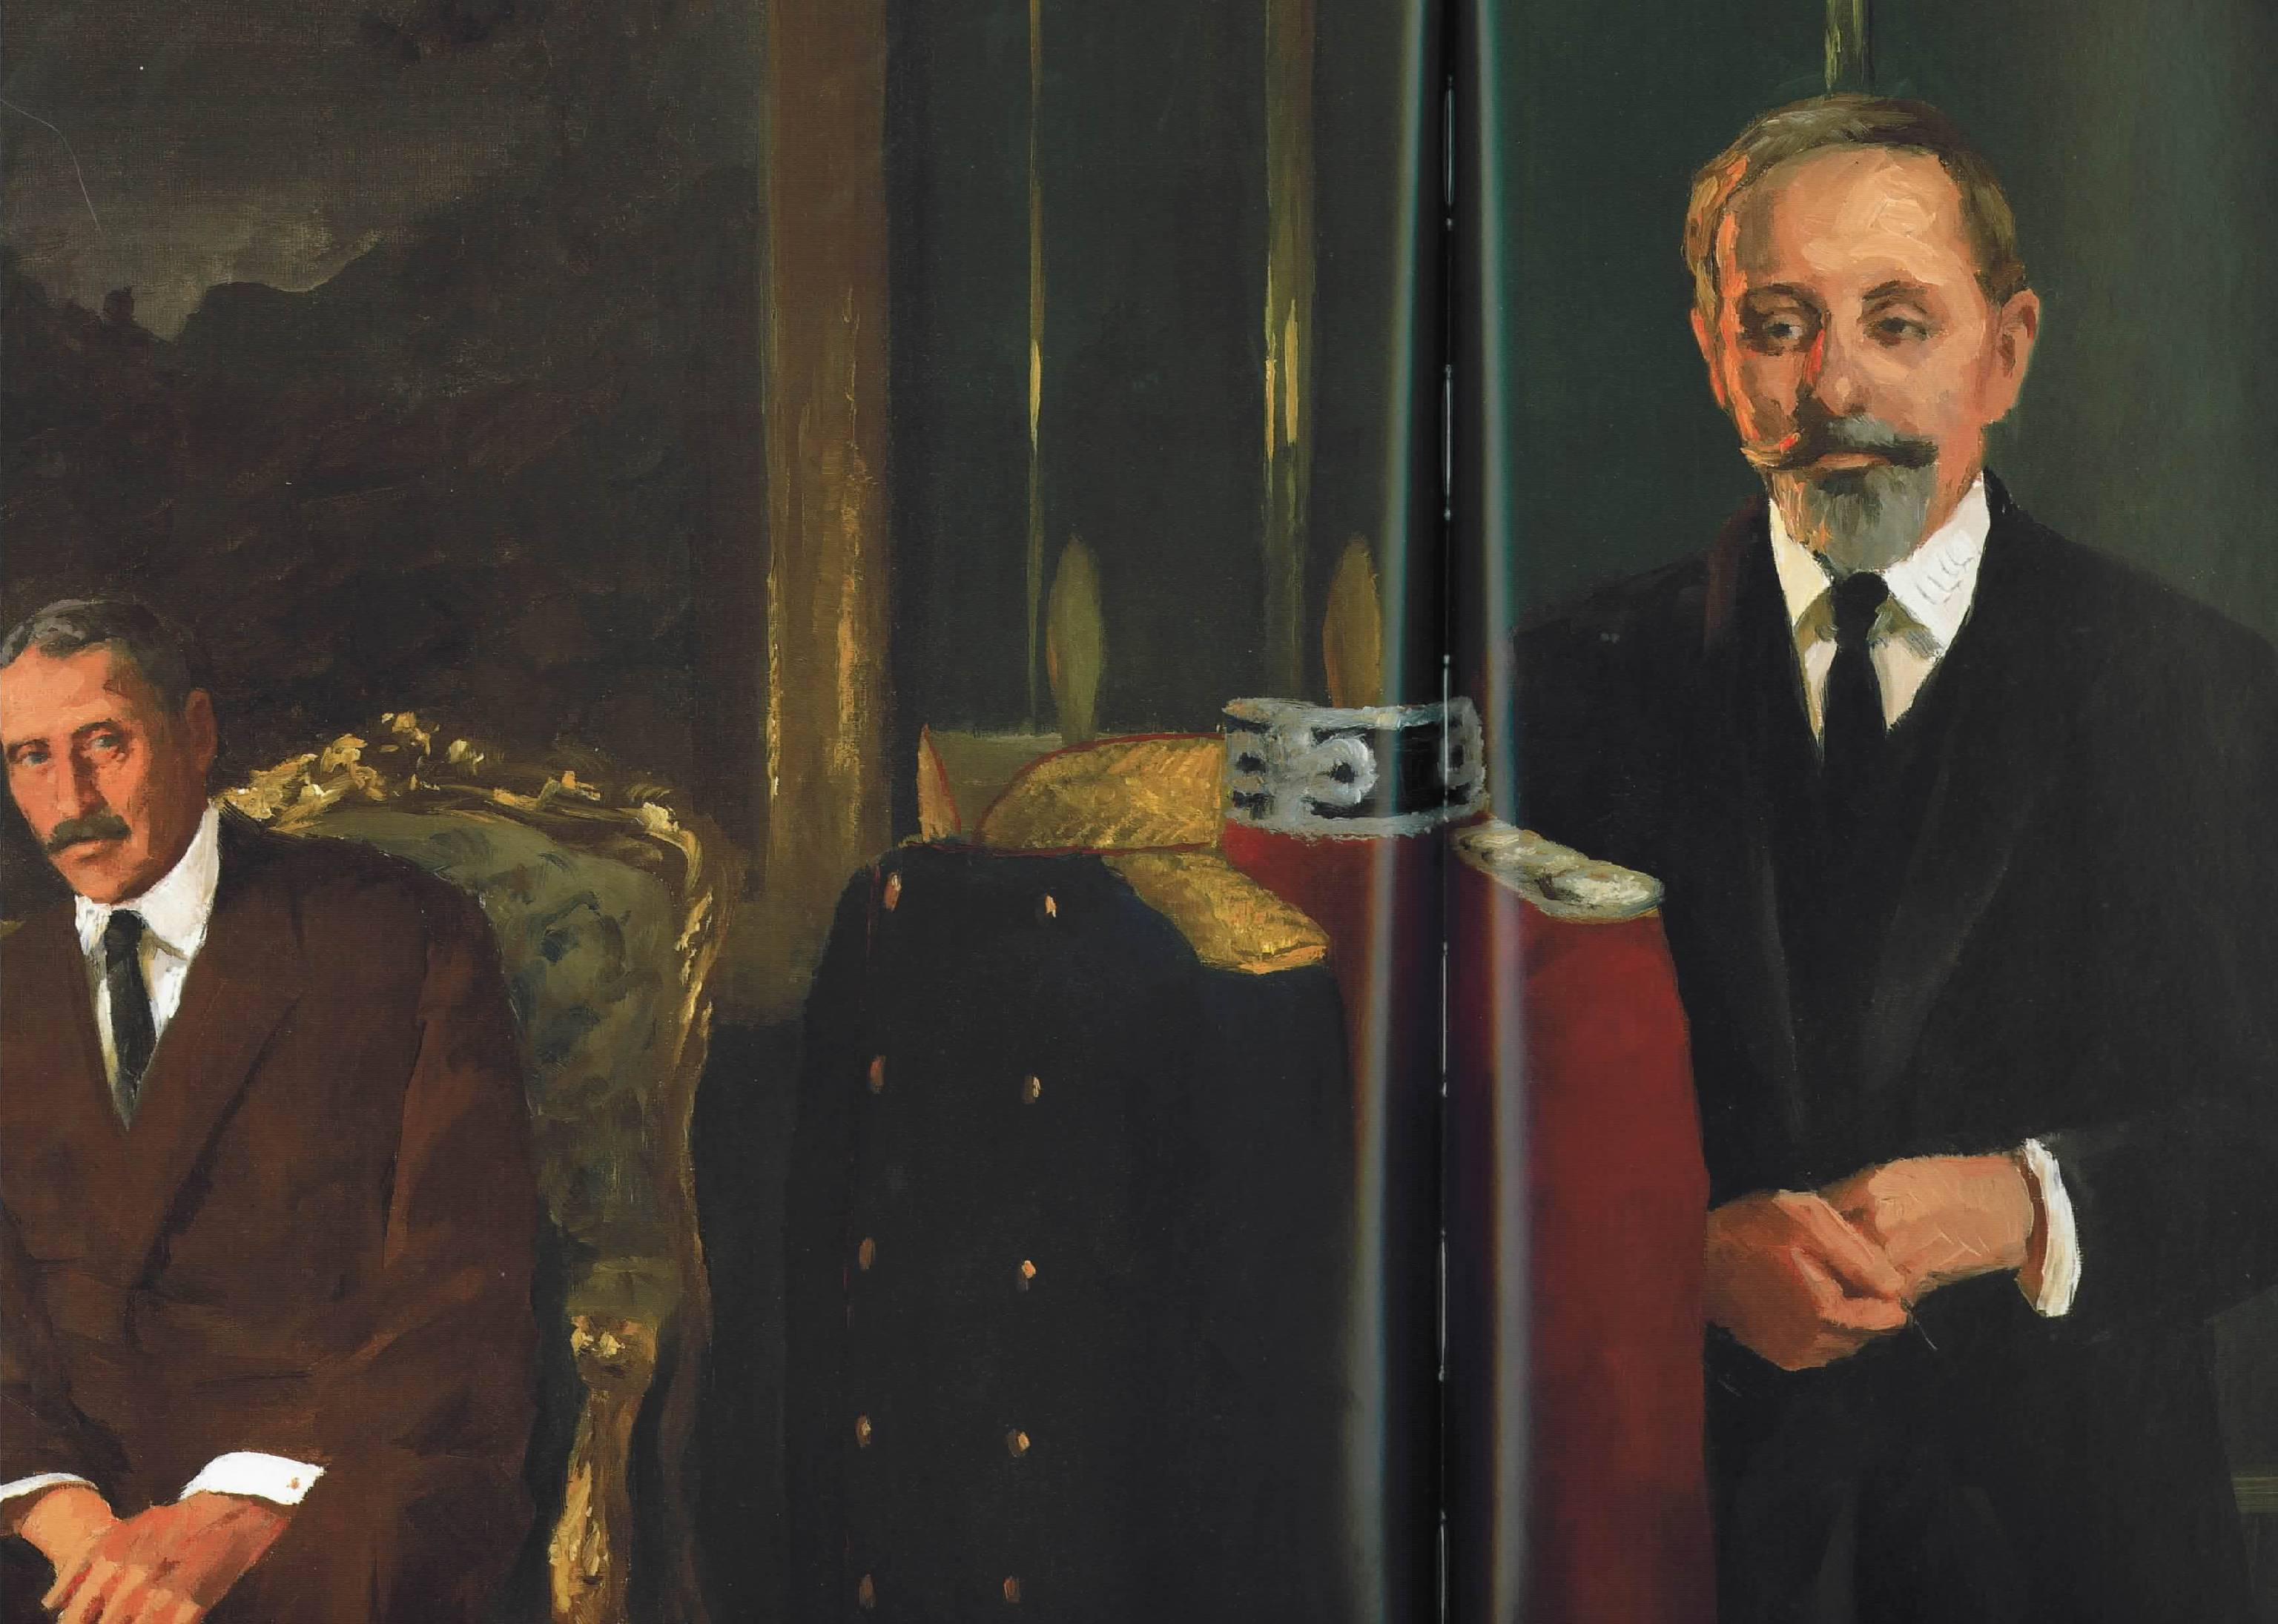
Notes:
cue: “…placing as much faith in his Danish subjects as they had in him.”

Slide 23
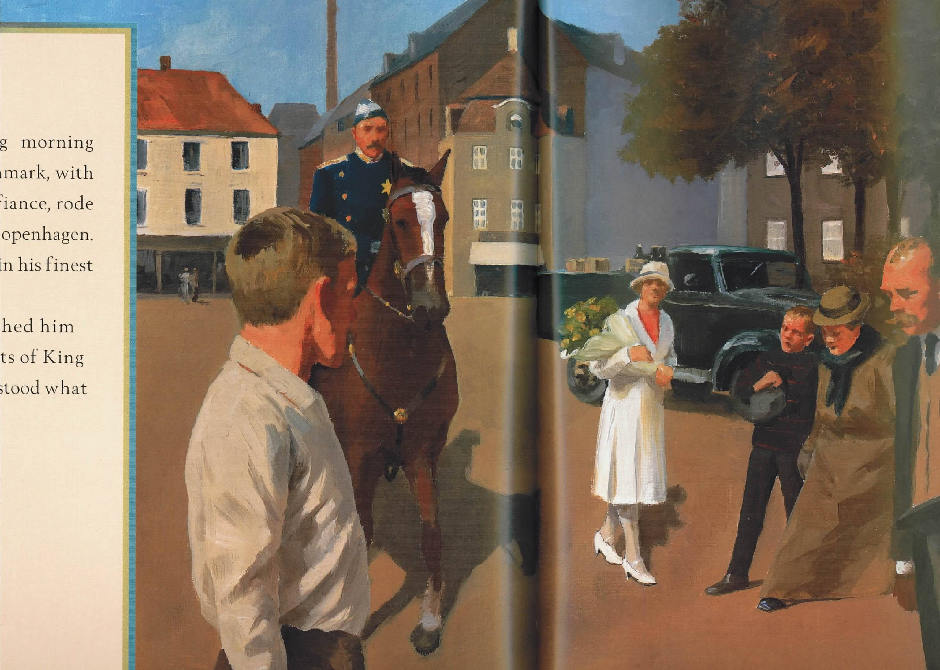
Notes:
cue: “…the subjects of King Christian understood what they should do.”

Slide 24
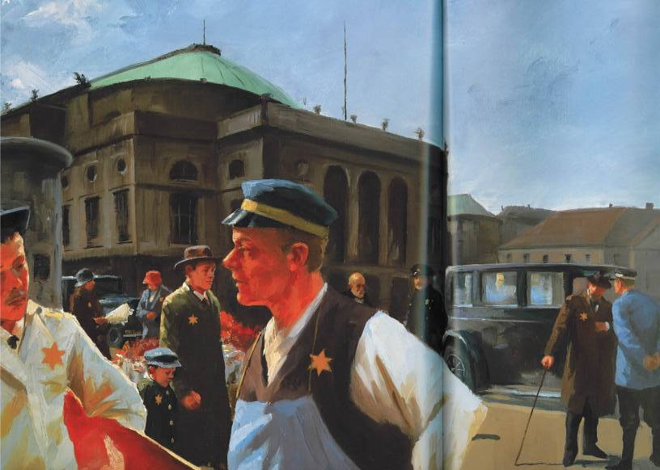
Notes:
cue: “…there were only Danes.”

Slide 25
Children’s Benediction
Go now in peace,
go now in peace.
May the Spirit of Love surround you
Everywhere, everywhere
you may go.
Notes:
Display while Benediction is sung to dismiss children from Sanctuary.

Slide 26
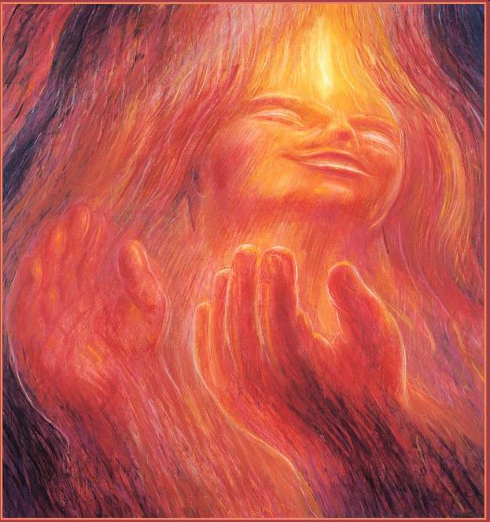
Meditation & Prayer
During the musical meditation, you are welcome to light a candle in the window. Return lighting sticks to the sand containers, hot end down.
Notes:
Display during Joys and Concerns and meditative/prayer while congregants walk to light window candles.
There will be a music interlude. Advance when music ends.

Slide 27

Hymn of Reflection
#287
“Faith of the Larger Liberty”
Notes:
Display *briefly* while WA introduces the hymn – advance when accompanist begins playing.

Slide 28
verse 1:
Faith of the larger liberty,
source of the light expanding,
law of the church that is to be,
old bondage not withstanding.
Faith of the free!
By thee we live ▬
by all thou givest and shalt give
our loyalty commanding.
Notes:
3 verses, 3 slides.

Slide 29
verse 2:
Heroes of faith in every age,
far-seeing, self-denying,
wrought an increasing heritage,
monarch and creed defying.
Faith of the free!
In thy dear name
the costly heritage we claim:
their living and their dying.
Notes:
3 verses, 3 slides.

Slide 30
verse 3:
Faith for the people everywhere,
whatever their oppression,
of all who make the world more fair,
living their faith’s confession:
faith of the free!
Whate’er our plight,
thy law, thy liberty, thy light
shall be our blest possession.
Notes:
3 verses, 3 slides.

Slide 31

Reading
1 Corinthians
Chapter 12,
Verses 12-20
Notes:
Display during Offering. Advance after worship associate thanks congregation.

Slide 32

Offering
This church is supported by the pledges of our members and friends. The offering provides an additional opportunity for expressing generosity by those attending today’s worship. You can also give online at communityuuchurch.org
Notes:
Display during Offering. Advance after worship associate thanks congregation.

Slide 33
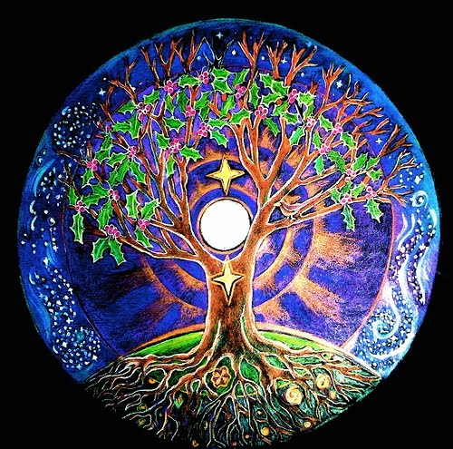
Offering Response
(please join in singing)
We are one, we are many
in a welcoming place.
In the deeds we accomplish,
we find our grace.
In one world connected
by nature so vast,
we now plant these blessings,
may they ever last.
We now plant these blessings,
may they ever last.
Notes:
While congregation sings after offering. Advance when speaker comes to the pulpit.

Slide 34
Notes:
Play video clip titled “Kiyimba story-school clip 2.mp4”

Slide 35
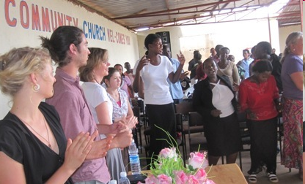
Unity and Diversity in the 21st Century
—Rev. Mark Kiyimba
Unitarian Universalist Church
of Kampala, Uganda

Slide 36


Slide 37
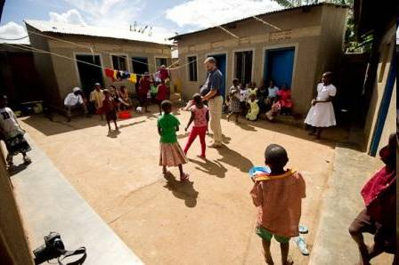

Slide 38
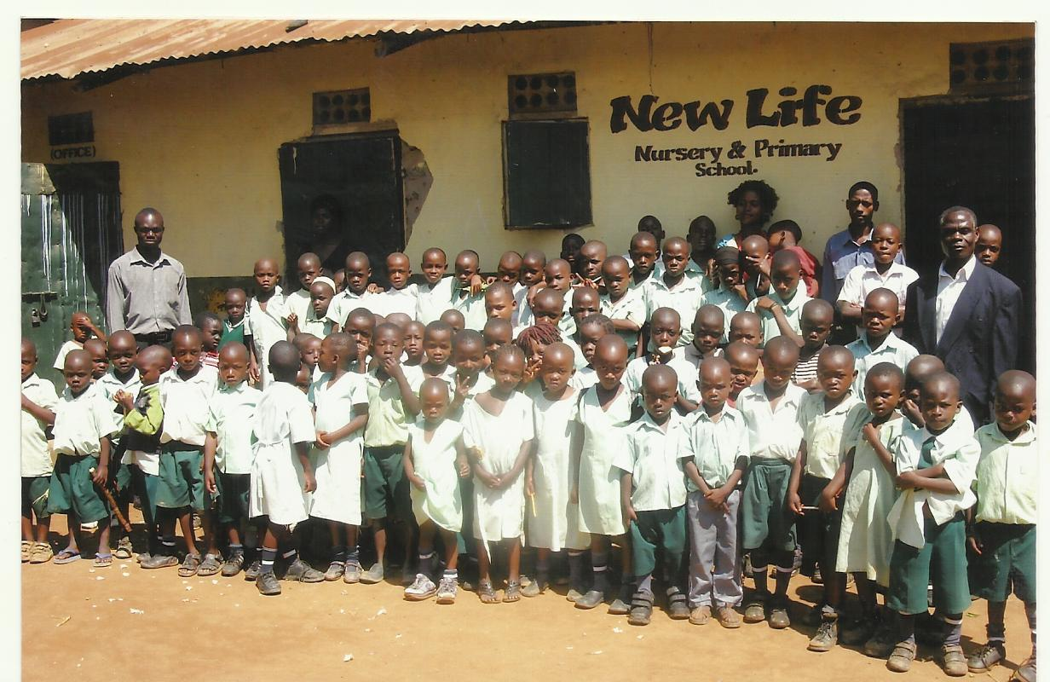
Special Offering

Slide 39
Closing Hymn
“Bwana Awabariki”
(insert)
Notes:
Display *briefly* while the hymn is introduced – advance when accompanist begins playing.

Slide 40
Bwana awabariki, Bwana awabariki,
Bwana awabariki, milele.
Ukimcha Bwana. Bwana awabariki.
Notes:
hymn 1033 in blue book (3 slides)

Slide 41
May God grant you a blessing,
May God grant you a blessing,
May God grant you a blessing, evermore.
Revere the Lord.
May God grant you a blessing.
Notes:
hymn 1033 in blue book (3 slides)

Slide 42
Bwana awabariki, Bwana awabariki,
Bwana awabariki, milele.
Notes:
hymn 1033 in blue book (3 slides)

Slide 43
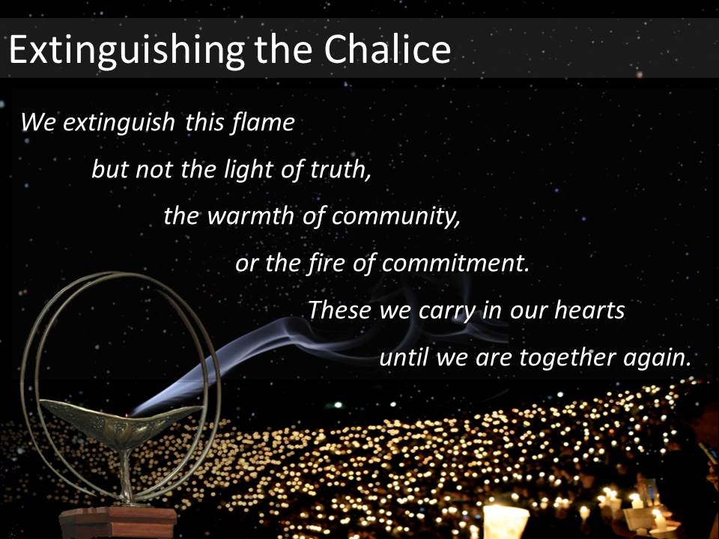
Notes:
Display while Extinguishing the Chalice.

Slide 44

Benediction
Notes:
Display during the Benediction

Slide 45
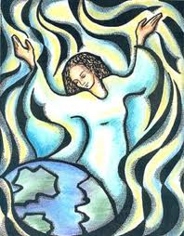
Fellowship
Everyone is invited to stay for coffee and conversation across the hall. You are also invited to join us back here in 10 minutes for Church Chats to discuss this morning’s service.
Notes:
Display during postlude and while people are exiting.

